Slide 1
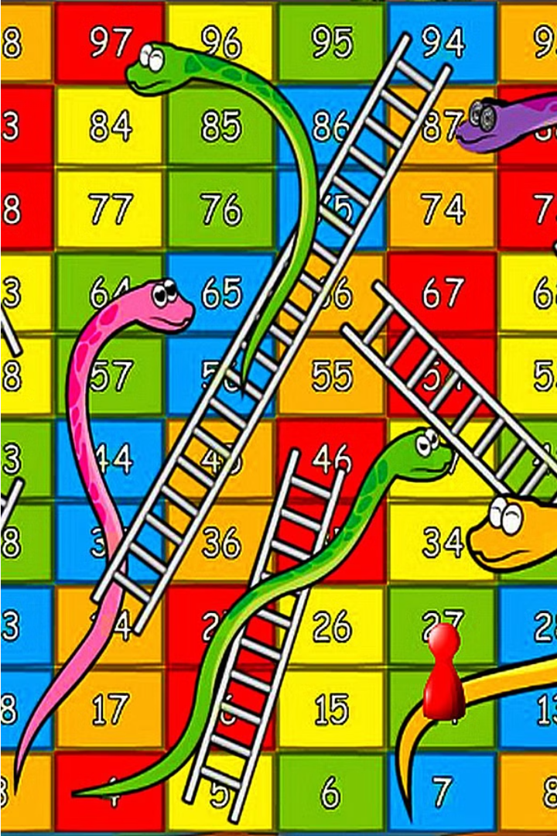
Snakes and Ladders Game Project Report
This project report details the development of a Snakes and Ladders game using the C programming language. The project was undertaken as part of the Data Structures Laboratory course at CMR College of Engineering & Technology. The report covers the game's design, implementation, and evaluation, showcasing the application of fundamental programming concepts and data structures.
R.Akshitha -23H51A05DY

Slide 2
Introduction
Game Objective
Snakes and Ladders
Gameplay Mechanics
The objective of the Snakes and Ladders game is to be the first player to reach the 100th square on the board. Players take turns rolling a die and moving their game piece forward the number of spaces indicated by the die roll.
The game features snakes and ladders that alter a player's position on the board. Landing on a snake's head sends the player down to the snake's tail, while landing on the bottom of a ladder sends the player up to the ladder's top.
The game is played by two players who take turns rolling a die. The player who reaches the 100th square first wins the game. The game is designed to be simple and engaging, making it suitable for players of all ages.

Slide 3

Abstract
Snakes and Ladders is a classic board game that can be efficiently replicated using the C programming language, combining simplicity with educational value. This project simulates the traditional game, adhering to its rules: the first player to reach 100 points wins, each player rolls a dice once per turn, and landing on a snake or ladder alters their position. The game supports two players who take alternating turns, with a random number generator simulating the dice rolls. Player positions are tracked with variables, and each roll advances the player's position, subject to adjustments if they encounter a snake or ladder. The game continues until one player reaches or exceeds 100 points, at which point the game declares a winner and ends.
In this project, data structures such as arrays or linked lists represent the board, capturing the locations of snakes and ladders. Additionally, structures encapsulate player details, including their name and current position on the board. The rand() function from the C standard library generates random dice rolls, ensuring fairness and unpredictability in the game. By employing these fundamental constructs, the game logic is clearly defined and executed, providing an immersive experience for the players.

Slide 4
Proposed System
Board Representation
Player Representation
The game board is represented using a one-dimensional array of size 100, with each element representing a square on the board. Specific indices within the array are designated as the starting and ending points of snakes and ladders.
Each player is represented by a structure that includes their name and current position on the board. The game supports two players who take turns moving their game pieces based on the dice roll.
Dice Simulation
Game Logic
A function simulates the rolling of a six-sided die using the rand() function from the C standard library. The result of the dice roll determines the number of squares a player moves forward.
The game logic handles the sequence of player turns, dice rolls, and position updates. After each dice roll, the player's new position is checked against the board array to determine if they have encountered a snake or ladder.

Slide 5
System Architecture
Start
Initialize Board
Initialize Players
Display Board
Player 1’s Turn
Player 2’s Turn
Roll Dice
Roll Dice
Move Player 1
Move Player 2
Player 1 wins?
Player 2 wins?
Display Board
End

Slide 6
Source Code
#include <stdio.h>
#include <stdlib.h>
#include <string.h>
#include <time.h>
#define BOARD_SIZE 100
typedef struct {
char name[50];
int position;
} Player;
void initializeBoard(int board[]) {
for (int i = 0; i < BOARD_SIZE; i++) {

Slide 7
board[i] = 0;
}
// Define snakes and ladders (example positions)
board[16] = -10; // Snake: move from 16 to 6
board[47] = -21; // Snake: move from 47 to 26
board[49] = -38; // Snake: move from 49 to 11
board[56] = -3; // Snake: move from 56 to 53
board[62] = -43; // Snake: move from 62 to 19
board[64] = -4; // Snake: move from 64 to 60
board[87] = -63; // Snake: move from 87 to 24
board[93] = -20; // Snake: move from 93 to 73
board[95] = -20; // Snake: move from 95 to 75
board[98] = -20; // Snake: move from 98 to 78
board[1] = 37; // Ladder: move from 1 to 38
board[4] = 10; // Ladder: move from 4 to 14
board[9] = 22; // Ladder: move from 9 to 31
board[21] = 21; // Ladder: move from 21 to 42

Slide 8
board[28] = 56; // Ladder: move from 28 to 84
board[36] = 8; // Ladder: move from 36 to 44
board[51] = 16; // Ladder: move from 51 to 67
board[71] = 20; // Ladder: move from 71 to 91
board[80] = 20; // Ladder: move from 80 to 100
}
void initializePlayer(Player* player, const char* name) {
strcpy(player->name, name);
player->position = 0;
}
int rollDice() {
return (rand() % 6) + 1;
}
void movePlayer(Player* player, int roll, int board[]) {
player->position += roll;
if (player->position >= BOARD_SIZE) {
player->position = BOARD_SIZE;
return;
}

Slide 9
player->position += board[player->position];
if (player->position < 0) {
player->position = 0;
}
}
void displayBoard(int board[], Player* player1, Player* player2) {
printf("Current Board Positions:\n");
for (int i = 1; i <= BOARD_SIZE; i++) {
if (i == player1->position && i == player2->position) {
printf("[B] "); // Both players
} else if (i == player1->position) {
printf("[1] "); // Player 1
} else if (i == player2->position) {
printf("[2] "); // Player 2
} else {
printf("[%d] ", i);
}

Slide 10
if (i % 10 == 0) {
printf("\n");
}
}
printf("\n");
}
void playGame(Player* player1, Player* player2, int board[]) {
while (player1->position < BOARD_SIZE && player2->position < BOARD_SIZE) {
printf("%s's turn. Press enter to roll the dice...\n", player1->name);
getchar();
int roll = rollDice();
printf("%s rolled a %d\n", player1->name, roll);
movePlayer(player1, roll, board);
printf("%s is now at position %d\n", player1->name, player1->position);
if (player1->position >= BOARD_SIZE) {
printf("%s wins!\n", player1->name);
break;}

Slide 11
printf("%s's turn. Press enter to roll the dice...\n", player2->name);
getchar();
roll = rollDice();
printf("%s rolled a %d\n", player2->name, roll);
movePlayer(player2, roll, board);
printf("%s is now at position %d\n", player2->name, player2->position);
if (player2->position >= BOARD_SIZE) {
printf("%s wins!\n", player2->name);
break;
}
displayBoard(board, player1, player2);
}
}
int main() {
srand(time(NULL));
int board[BOARD_SIZE];
Player player1, player2;

Slide 12
initializeBoard(board);
initializePlayer(&player1, "Player 1");
initializePlayer(&player2, "Player 2");
printf("Welcome to Snakes and Ladders!\n");
displayBoard(board, &player1, &player2);
playGame(&player1, &player2, board);
return 0;
}

Slide 13
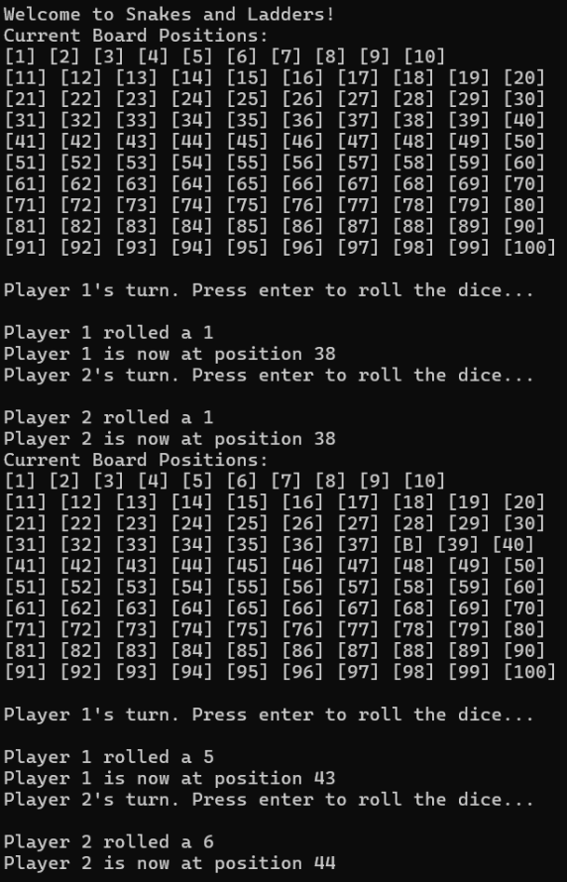
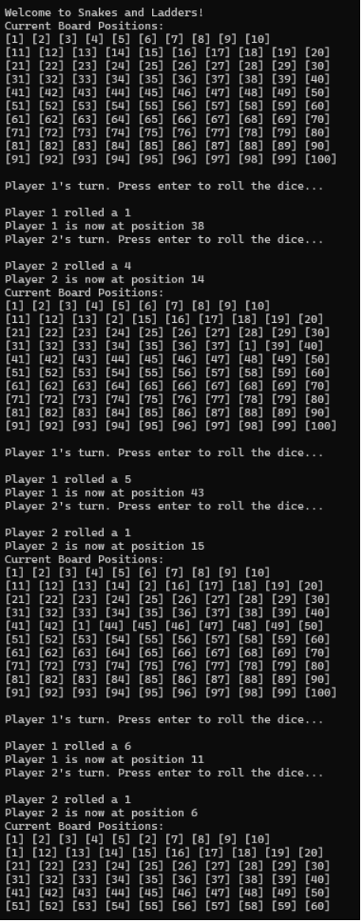
Results and Discussion

Slide 14
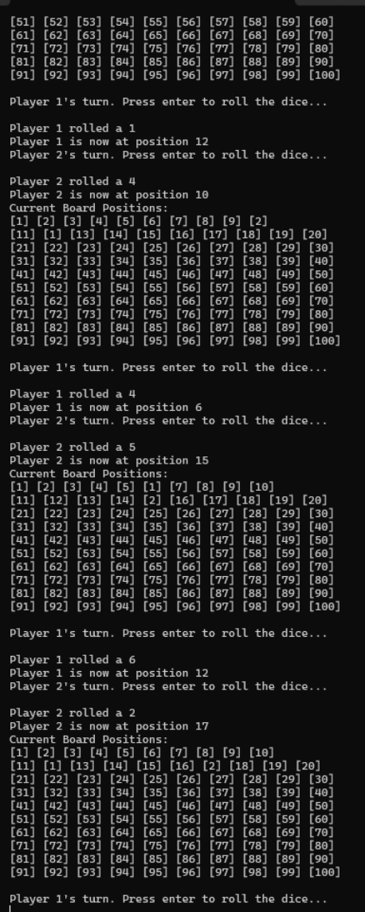
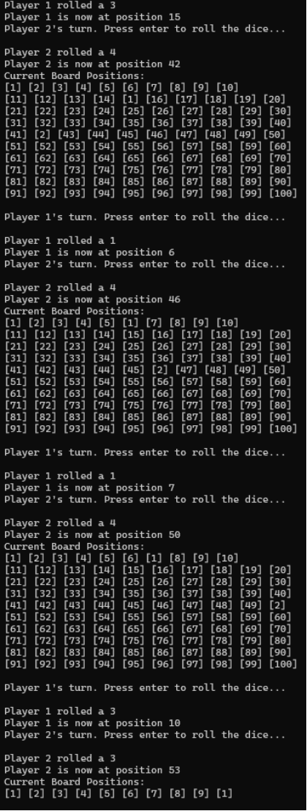

Slide 15
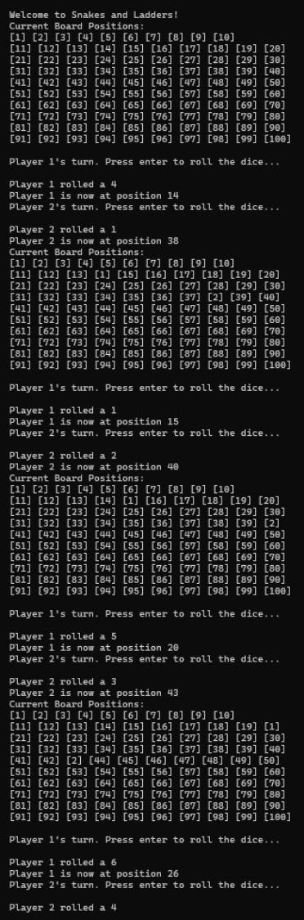
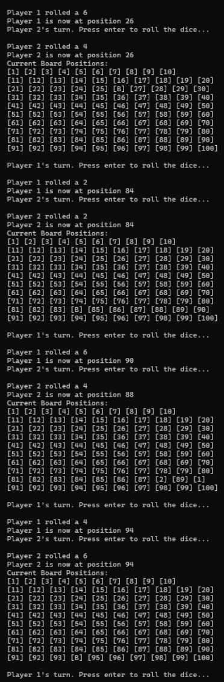

Slide 16
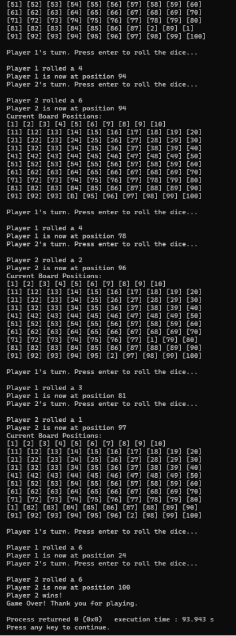

Slide 17

Conclusion
Educational Value
Project Outcomes
Future Enhancements
The Snakes and Ladders game project provides a practical and engaging way to learn and apply fundamental programming concepts in C. The project demonstrates the use of arrays, structures, loops, conditionals, and random number generation in a real-world context.
The project successfully implemented a functional Snakes and Ladders game in C. The game adheres to the traditional rules and provides a user-friendly interface for players to interact with.
The project can be further enhanced by adding features such as a graphical user interface, multiplayer support, customizable board configurations, and AI opponents.

Slide 18
Future Enhancement
The Snakes and Ladders game project offers a solid foundation, but there are several potential enhancements that can be made to improve and expand its functionality.
By incorporating these enhancements, the Snakes and Ladders game can be transformed from a basic console application into a rich, interactive, and versatile gaming experience. These improvements not only increase the game's appeal but also provide additional learning opportunities in various areas of software development.

Slide 19


